Slide 1

Azure Cosmos DB for AI

Slide 2
AI has forever changed what software makes possible (and what we expect from it)
It’s elevating our expectations
It’s reshaping
every industry
It’s rejuvenating transformation
ChatGPT crossed 1 million users in 5 days of launch, setting the platform record¹
The value of AI is projected to increase 13x—to $15.7 trillion by 2030²
87% of organizations believe AI will give them a competitive edge³
¹OpenAI public statements
²Global Artificial Intelligence Study: Exploiting the AI Revolution, PwC
³AI Global Executive Study and Research Project, MIT Sloan and BCG
Notes:
Generative AI has fundamentally changed what we can accomplish with software and changed our expectations of software.
It’s driving tremendous adoption of services, it’s reshaping industries, and it’s prompting organizations to consider how they can use AI and what new digital products, services, and experiences they can create.
Sources:
1. https://twitter.com/gdb/status/1599683104142430208?lang=en
2: https://www.pwc.com/gx/en/issues/data-and-analytics/publications/artificial-intelligence-study.html
3. https://sloanreview.mit.edu/projects/expanding-ais-impact-with-organizational-learning/?utm_medium=pr&utm_source=release&utm_campaign=ReportBCGAI2020

Slide 3
AI has forever changed what software makes possible (but somethings remain the same)
Generative AI has the potential to create $2.6 to $4.4 trillion in value across industries and automate activities that absorb 60–70% of employees’ time.
Apps are the centerpiece of our digital economy
83% of enterprise decision makers plan to increase AI spend this year¹
Apps are where the power of AI and data come to life
¹The economic potential of generative AI
McKinsey June 2023
Notes:
Generative AI has fundamentally changed what we can accomplish with software and changed our expectations of software.
It’s driving tremendous adoption of services, it’s reshaping industries, and it’s prompting organizations to consider how they can use AI and what new digital products, services, and experiences they can create.
Sources:
1. https://twitter.com/gdb/status/1599683104142430208?lang=en
2: https://www.pwc.com/gx/en/issues/data-and-analytics/publications/artificial-intelligence-study.html
3. https://sloanreview.mit.edu/projects/expanding-ais-impact-with-organizational-learning/?utm_medium=pr&utm_source=release&utm_campaign=ReportBCGAI2020

Slide 4
What is an AI Agent?
Planning. AI agents can create step-by-step plans and can use feedback to improve refine future outputs.
Memory. Agents rely on short-term memory for immediate prompts and leverage long-term data retention—often via retrieval-augmented generation (RAG)—for broader context and recall.
Perception. AI agents can retrieve data and process information making them more interactive and contextually aware.
Tool Use. Agents can run functions or call external APIs for information or to perform actions. These are also called tools.
“An agent is a system that uses an LLM to decide the control flow of an application” – LangGraph

Slide 5
AI Agents are a lot like “intelligent” functions
Has inputs & outputs.
Functions take arguments and can (optionally) return something,
AI agents process prompts or data and then generate responses or actions.
Encapsulates logic
Functions contain code that executes a specific task.
AI agents encapsulate reasoning steps and decision-making processes.
Modular & reusable
Both Functions and AI agents can be “called” repeatedly in different parts of an application each time performing their specialized task.
Composable
Both Functions and AI Agents and can be chained or orchestrated with other agents/functions, enabling complex workflows from simpler building blocks.

Slide 6
Two popular agentic architectures
Single-Agent
Router (Supervisor, Planner) Multi-agent
🤖
LLM
🔨
Tool
🤖
LLM
🤖
LLM
🤖
LLM
🤖
LLM
…
🔨
Tool
…
🔨
Tool
🔨
Tool
🔨
Tool
🔨
Tool
Notes:
Why multiple agents?
As you develop these systems, they might grow more complex over time, making them harder to manage and scale. For example, you might run into the following problems:
Over-Tooling Confusion
When an agent has too many tools, it can make inefficient decisions about which tool to call next.
This creates confusion and can lead to suboptimal or redundant steps in the workflow.
Context Overload
As the conversation or task grows more complex, a single agent may struggle to keep track of all relevant details.
Important information can fall through the cracks, negatively affecting performance and outcomes.
Need for Specialized Expertise
Tasks like planning, researching, math calculations, and more each require different skill sets.
A single agent might lack the depth of expertise needed to handle all specialized areas effectively.
Break It Down into Multiple Agents
Consider creating several smaller, independent agents, each responsible for a specific domain or function.
These agents can be as simple as a straightforward prompt and a single LLM call, or as sophisticated as a full-fledged ReAct agent.
By composing these specialized agents into a multi-agent system, you can improve decision-making, maintain clarity on complex contexts, and leverage targeted expertise for better overall performance.
Multi agent scenarios provide multiple benefits
Modularity
Separate agents simplify development, testing, and maintenance.
Specialization
Domain-focused agents boost performance by bringing targeted expertise.
Control
Explicitly manage agent-to-agent communication for greater oversight and stability.

Slide 7
Why multi-agent?
Multi-agent applications utilize multiple specialized LLMs working collaboratively to address complex tasks.​
Specialized agents can handle distinct tasks leading to more deterministic and accurate outcomes compared to a single, generalist LLM. ​
By assigning specific roles to different LLM agents, such as data retrieval, analysis, tool usage, etc., they can communicate and coordinate to solve problems more effectively and predictably.

Slide 8
This workshop
User
🧑‍💻
Coordinator Agent
Tool
Transfer to agent
Tools
Tools
Bank transfer
Get offer information
Bank transaction
Create account
Get transaction history
Sales
Agent
Support
Agent
Transactions
Agent
Calculate monthly payment
Bank balance
Tools
Service request
Get branch locations

Slide 9
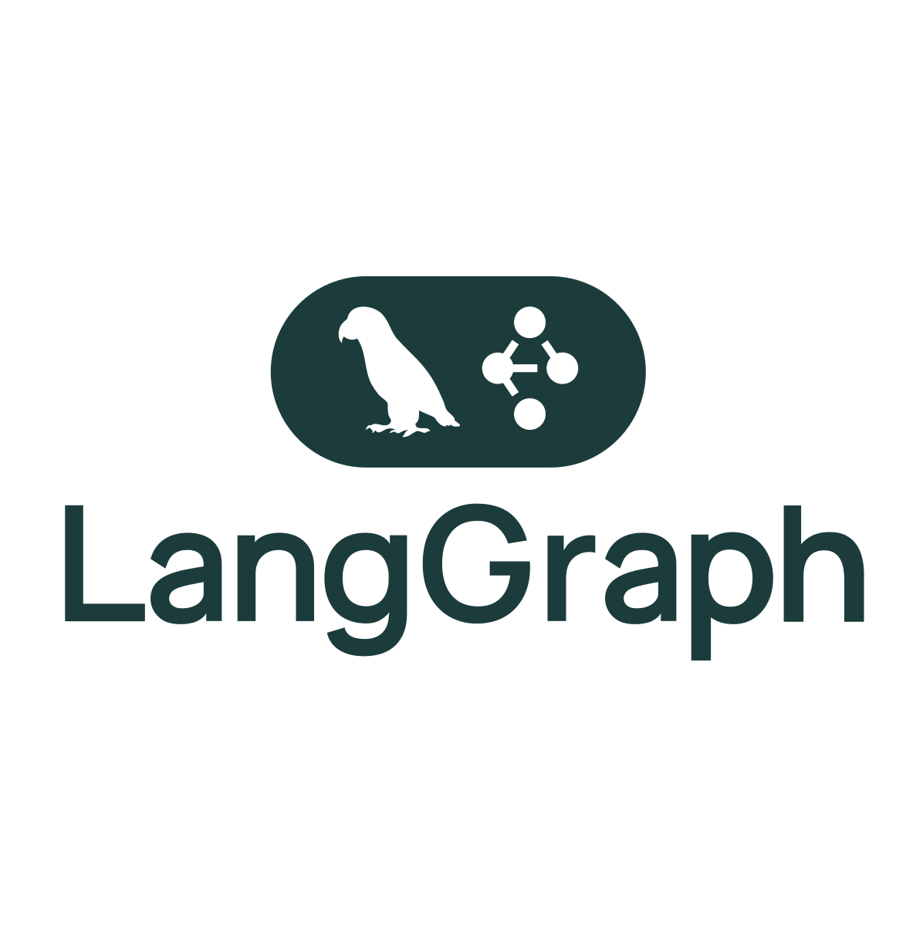
Introduction to LangGraph
An intuitive, open-source framework for building multi-agent AI workflows and orchestrations in Python.
It simplifies the integration of language models, external tools, and APIs, allowing developers to rapidly construct complex AI systems without repetitive coding.
It also facilitates clear state management, agent coordination, and robust control flows to streamline development of scalable AI solutions.
Key features
Agent Routing and Flow Control
Multi-Agent Collaboration
Checkpointing and Memory Management
Integrated Tool Calling
Can leverage LangChain capabilities
Flexible State Management
Time Travel for Debugging and Analysis
Notes:
Nodes do the work. edges tell what to do next

Slide 10
LangGraph - Graphs
Components
Entry point
Example
A node
An edge
Agent node
Action
Action
A conditional edge
Tool
Tool
A tool / function
End node
10
Sources:
https://langchain-ai.github.io/langgraph/concepts/low_level/#graphs
https://learn.deeplearning.ai/courses/ai-agents-in-langgraph
Notes:
Nodes do the work. edges tell what to do next

Slide 11
LangGraph - Tools
Tools are an easy way to associate Python functions with a schema defining the functions name, description, and arguments.
These can be invoked by a model, and outputs can be fed back into the model.
Some outputs can be “artifacts”, or objects that can’t be directly passed to a model but need to be passed to downstream tasks.
Tips
Design tools with clear naming, documentation, proper type hints to facilitate ease of use by models.
Develop simple or narrowly scoped tools to ensure accurate and efficient model utilization.​
Example code:
from langchain_core.tools import tool
@tool
def multiply(a: int, b: int) -> int:
"""Multiply two numbers.""“
return a * b

Slide 12
State & Memory
State
A snapshot of your agentic application.
It can contain any information useful to describe the snapshot.
Ideally, it should have enough information such that the application can be restored at a given state.
It can also help maintain consistency and context, enabling agents to perform tasks effectively and coordinate with each other.​
Short -Term Memory
Storage of information within a single session or interaction, allowing agents to maintain context during that session.​
Enables coherent and contextually relevant responses by remembering recent interactions.​
Long-Term Memory
Persistent storage of information across multiple sessions, enabling agents to recall past interactions and user preferences over time.​
Allows agents to learn from feedback, adapt to user preferences, and provide personalized experiences.​
Integrates with external databases to retain information between sessions.

Slide 13
LangGraph - Checkpointers
Easy state management. Capture and store the current state of agents, including the data they're handling, their internal status, and relevant context. This simplifies tracking the progress and condition of your agents.
Reliable persistence. Save states securely to durable storage (like databases or file systems). This means your application can easily recover its previous state after restarts or system crashes, minimizing downtime and ensuring reliability.
Effortless restoration. Restore agents to previously saved checkpoints. This feature allows applications to resume smoothly from specific, stable points without reprocessing earlier steps.
Consistency across agents. In distributed or multi-agent systems, checkpointers ensure consistent states by coordinating checkpoints across different agents, even when they operate in separate nodes or environments.
Customizable configuration. Developers can control how often and under what conditions checkpoints are created. This flexibility helps balance performance and reliability based on specific needs.
Built-in memory. Enable agents to "remember" past interactions, essential for ongoing conversations or repetitive tasks. This persistent memory maintains context across multiple interactions, enhancing user experience and interaction continuity.
Time travel & debugging. Allowing developers to replay past executions to review, debug, or analyze specific interactions. Additionally, developers can fork the graph state at any checkpoint, exploring alternative scenarios or debugging different pathways.
Azure Cosmos DB Checkpointer: https://github.com/shengbo-ma/langgraph-checkpoint-cosmos

Slide 14
Keep up with Azure Cosmos DB pace of innovation (announced at Build): What does it mean for you?
Azure Cosmos DB for NoSQL
Vector Search in Azure Cosmos DB for NoSQL (powered by DiskANN ): The fastest, more sophisticated, performant, and the only Serverless Vector Database in the Market to deliver on your Intelligent Apps most demanding requirements
Azure Cosmos DB for NoSQL integrations in LangChain and Semantic Kernel: More flexible development and more robust applications
Azure Cosmos DB for NoSQL Computed Properties Speed, performance and Dev simplification
Serverless to provisioned account migration: The ability to start small in serverless mode and transparently migrate to Provisioned mode when you go into production will make it much easier to go from Dev to Prod and will guarantee the best TCO while you are developing your App
Dynamic Autoscaling for RU based Azure Cosmos DB Will deliver you the best TCO in the market, regardless of size, scale, distribution or Partitioning strategy
vCore-based Azure Cosmos DB for MongoDB
Cross-region DR in vCore-based Azure Cosmos DB for MongoDB More resilient Applications with vCore based CosmosDB
New Azure regions for vCore-based MongoDB Increased availability in your Geographic region
Autoscaling in vCore-based Azure Cosmos DB for MongoDB Meet demand while keeping your cost low, without manual interventions
Developer Improvements
Go SDK
Vercel Integration More Developer flexibility to use their tools and SDKs of choice

Slide 15
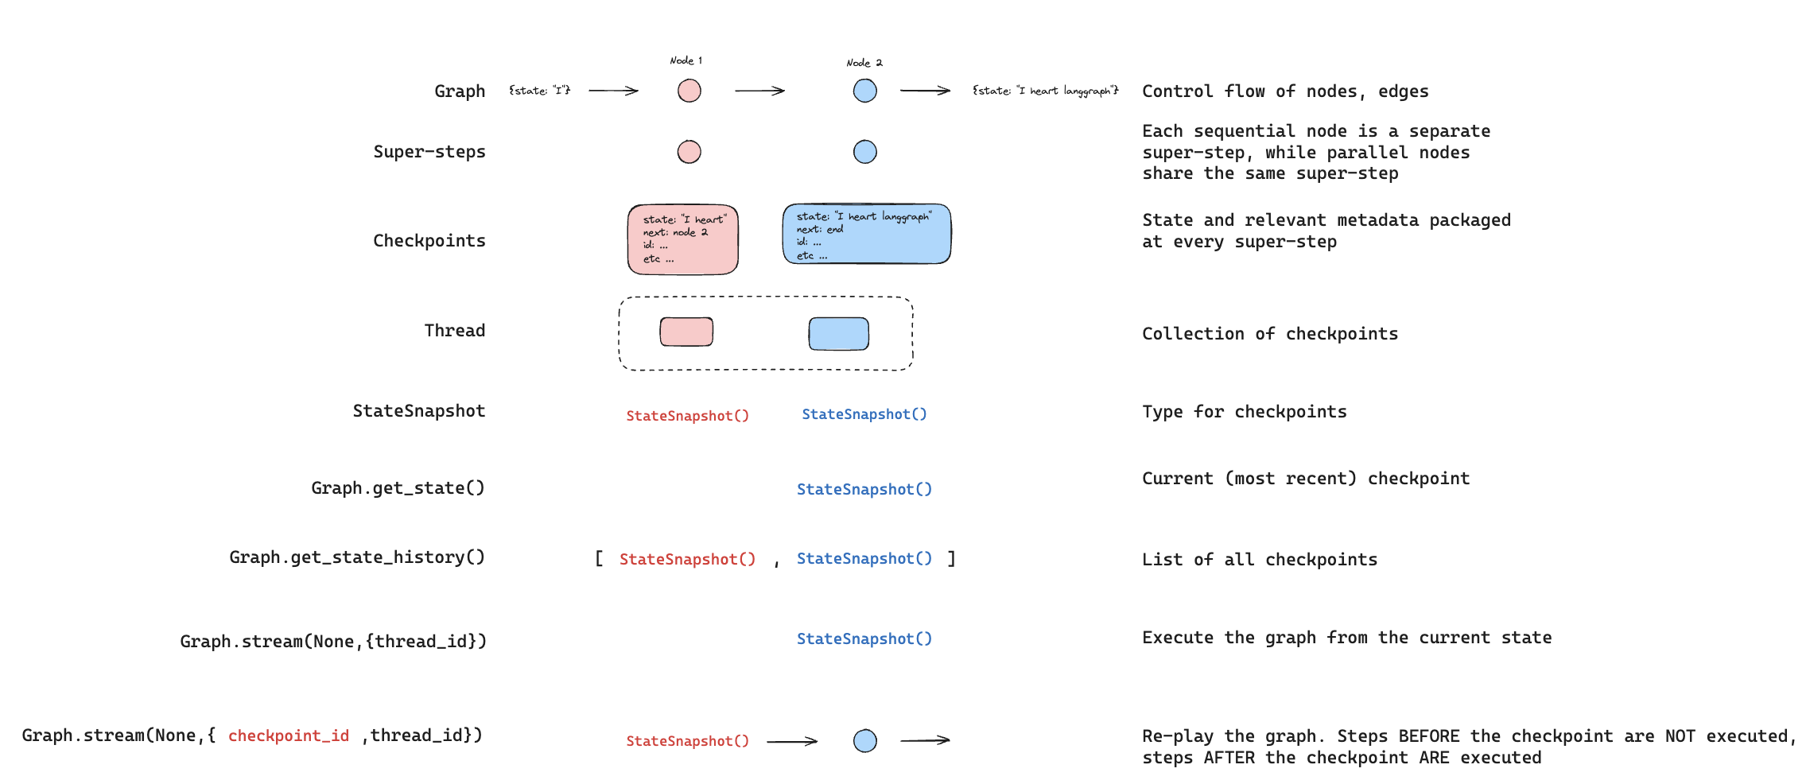
LangGraph – Persistence Glossary
Source: https://langchain-ai.github.io/langgraph/concepts/persistence/

Slide 16












GenAI + Data Use Cases with Azure Cosmos DB
Operational + Vector Database
Retrieval Augmented Generation (RAG)
Conversational History
Semantic Caching
AI Agents
No ETL
Consistent data
Reduce complexity & costs
Personalize LLM on your data
Cheaper than fine tuning
Faster iteration on new data
Conversational context
UX improvements
LLM optimizations
Auditing
Drastically reduces latency
Saves on Token consumption
Reduces costs and latency for LLM
Agent-to-agent transactions
Statefulness
Logging
Notes:
Azure Cosmos DB is Microsoft’s fastest growing database for AI apps.
70% of AI Design Wins include Azure Cosmos DB, and 77% of Cosmos DB’s pipe is build/modernize AI.
Customers use Cosmos DB to combine the operational and vector database – reducing the complexity required to maintain consistency across separate operational and vector databases.
They implement RAG pattern to personalize their LLM responses – and not just chatting with generic documents – but including operational context such as advice based on the customer’s purchase history.
The easiest and most common use-case to sell is chat history – which enables chat experiences to maintain conversational context and to power LLM Ops to know whether prompt engineering improved the quality of GenAI responses.
Conversational history can be extended to power semantic caching to further reduce costs and improve performance of the LLM.
And of course, the most recent trend is AI Agents – where customers use Cosmos DB to power statefulness for agent-to-agent transactions and logging their interactions for LLM Ops.

